Slide 1
FoodieKeepers
Software Engineering
Yeol Yang Information System 2018057701
Daphnée Correia Electrical eng. 9073020219
Edouard Maurice Information System 9073620215
Pacôme Manceaux Electrical eng. 9078720216

Slide 2
table of contents
01
02
Introduction
ARCHITECTURE & Implementation
03
04
Functions
conclusion

Slide 3
01
introduction

Slide 4
—some statistics
“ One third of all food produced is lost or wasted –which represents around 1.3 billion tonnes of food –costing the global economy close to $940 billions each year. »
ʻ
ʻ
“Up to 10% of global greenhouse gases comes from food that is produced, but not eaten.»
“If one quarter of the food currently lost or wasted could be saved, it would be enough to feed 870 million hungry people.»

Slide 5
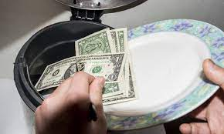
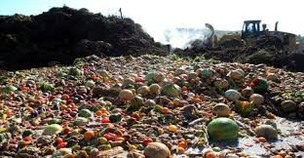
Economic & Environmental consequences
Economic consequences
Environmental consequences
165$ billion a year on the production of food that is never eaten
food waste often buried in landfills
Creates toxic effluent and methane
750$ millions dollars a year to dispose of this unused food

Slide 6
Reuniting Consumers AND restoration/food industry
Consumers
Restaurants/Grocery stores

Slide 7
02
ARCHITECTURE & Implementation

Slide 8



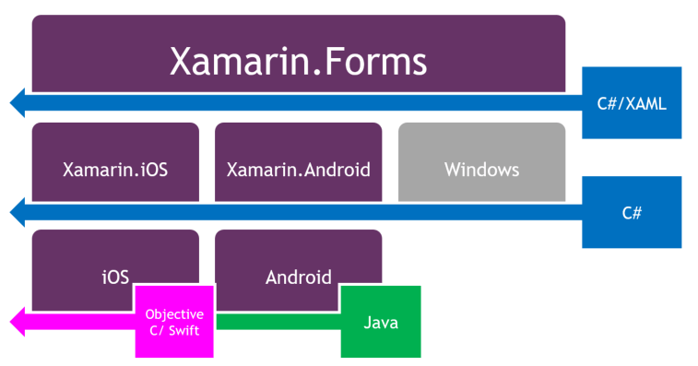


FOODIE KEEPERS FRAMEWORK
90%

Slide 9
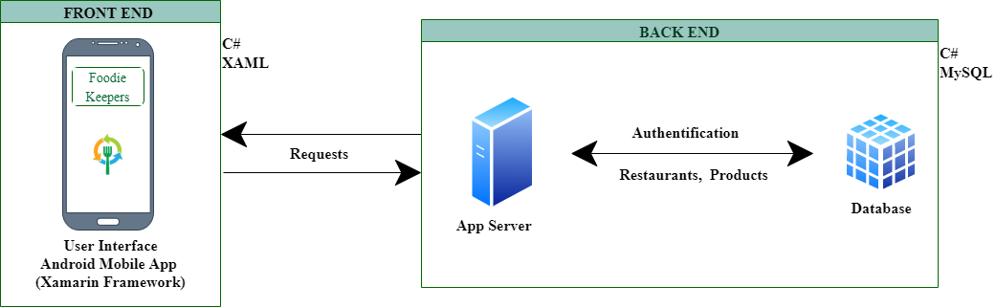

OVERALL ARCHITECTURE

Slide 10
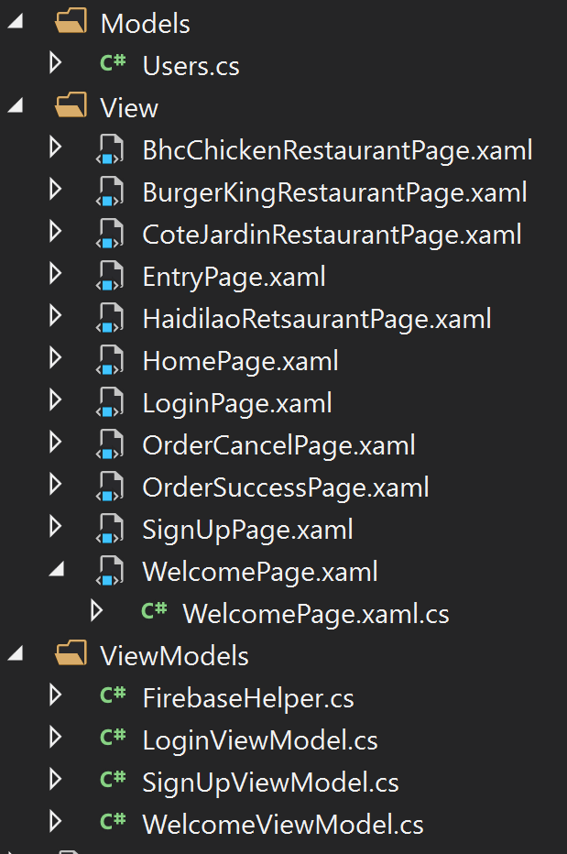
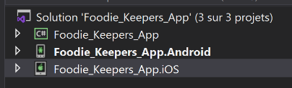
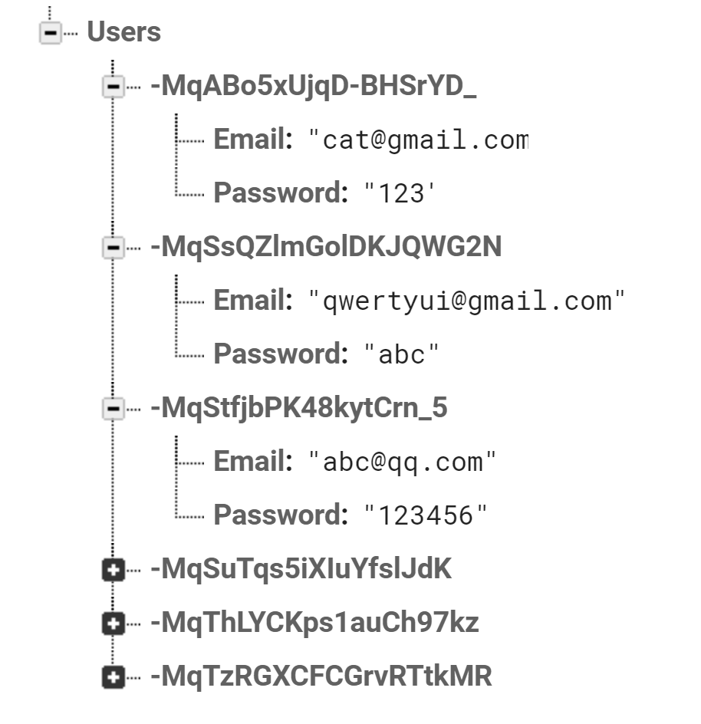
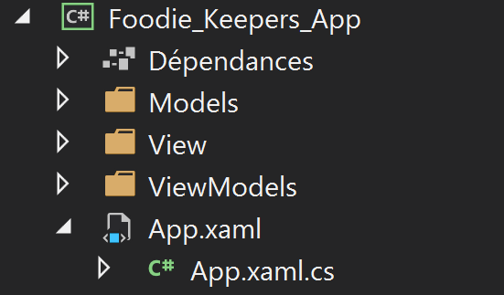

APPLICATION CODE

Slide 11
03
Functions

Slide 12
OUR SERVICES
Sign up
cancel
login
Search by category
order
Pay online
to sign one's name (as to a contract) in order to join to our app
It a user does’t want to buy the food any more, he can cancel
a username and password that allows a user to log in to our app
A user can search the food by the category
If the user want to buy the food, he can use order to take that
A user can pay online

Slide 13
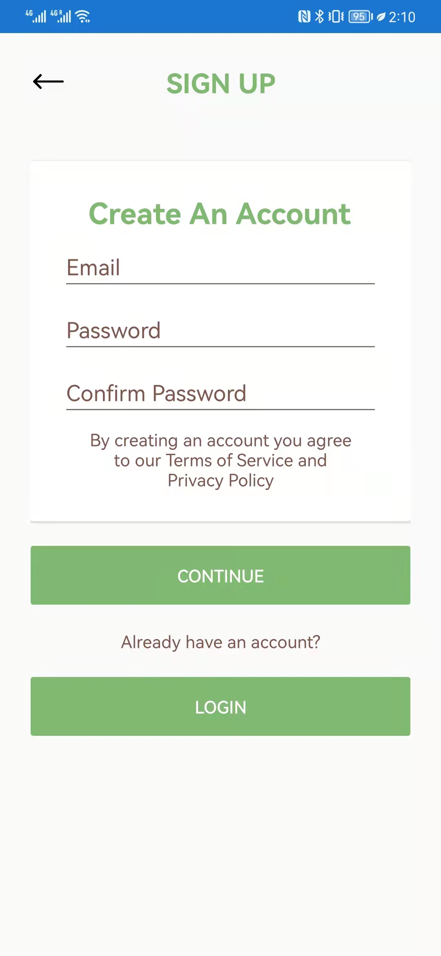
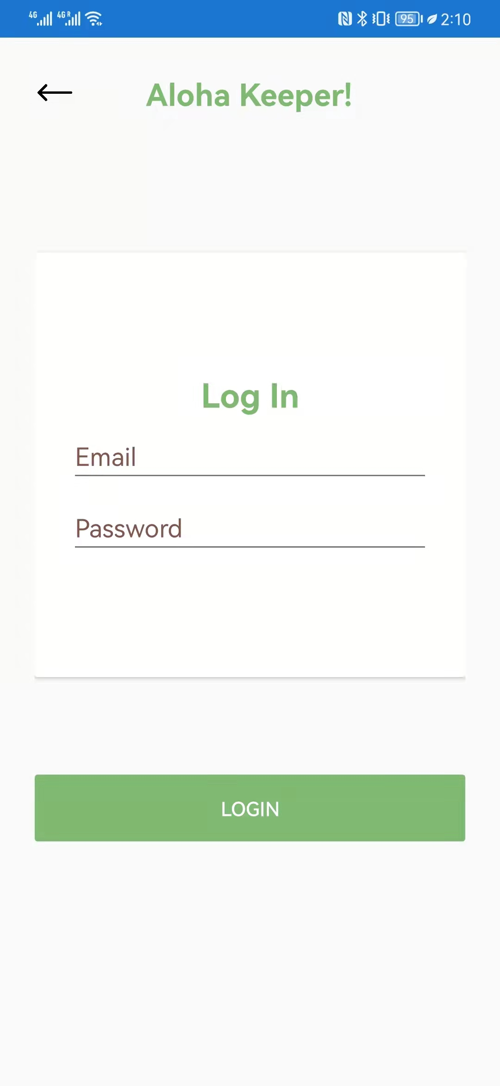
Functions – sign up
Sign up
login
to sign one's name (as to a contract) in order to join to our app
a username and password that allows a user to log in to our app

Slide 14
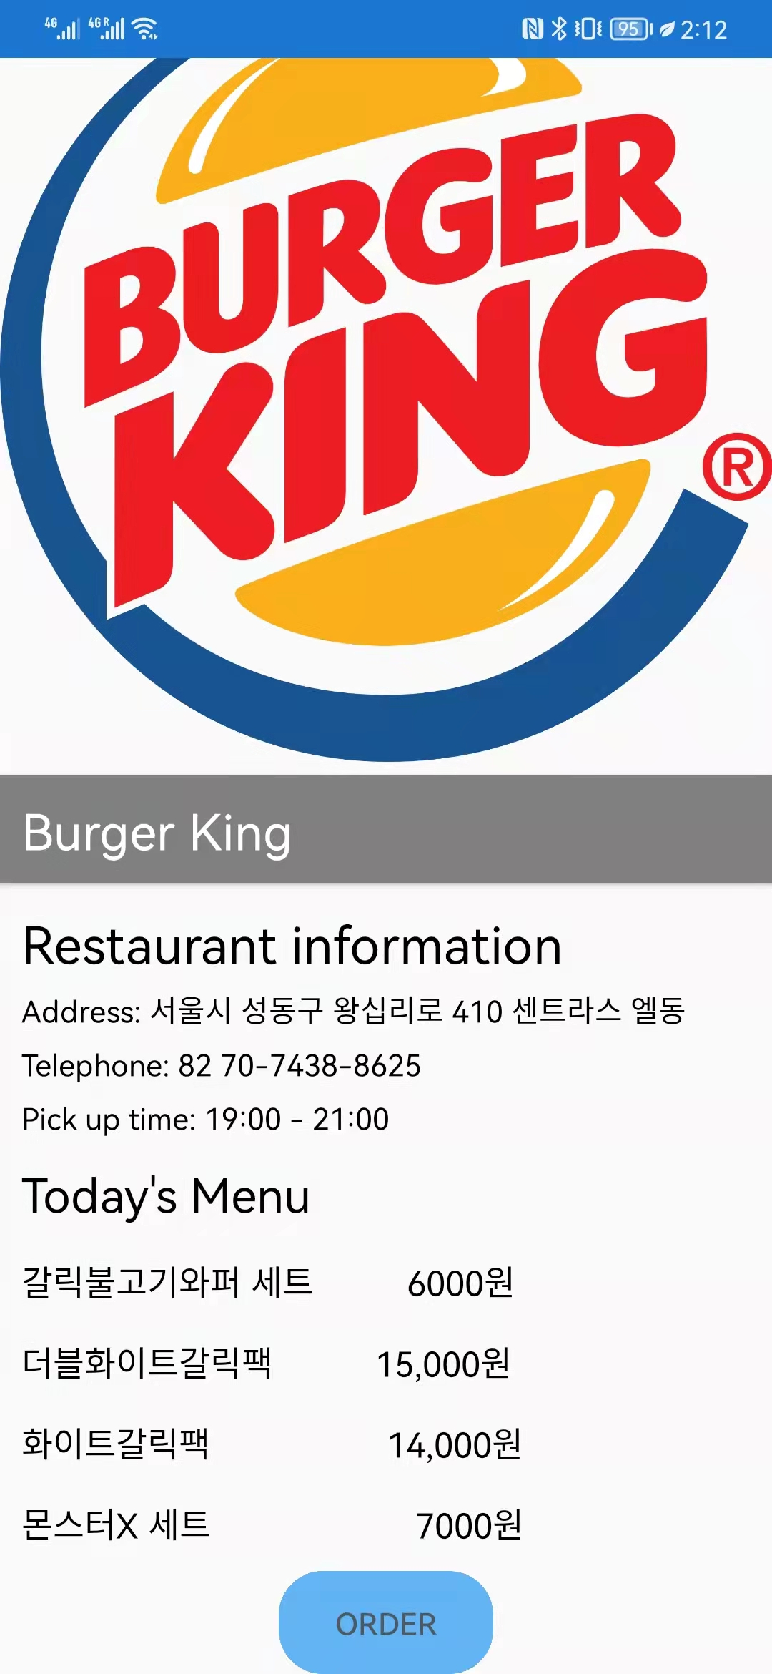
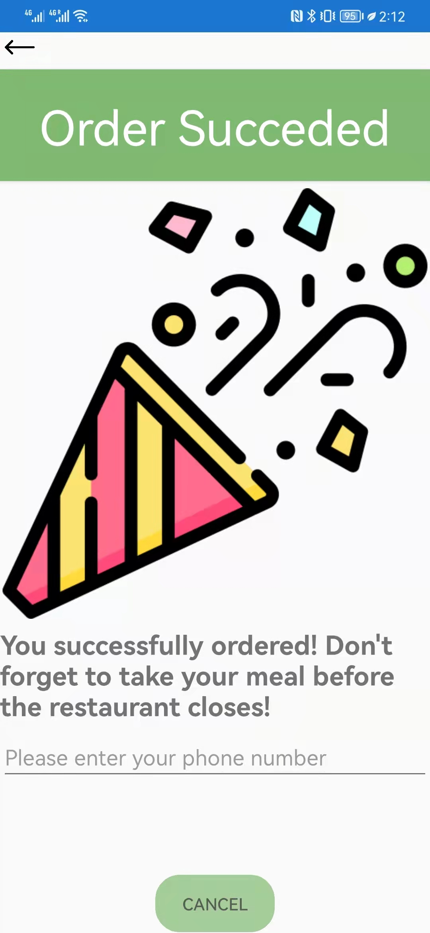
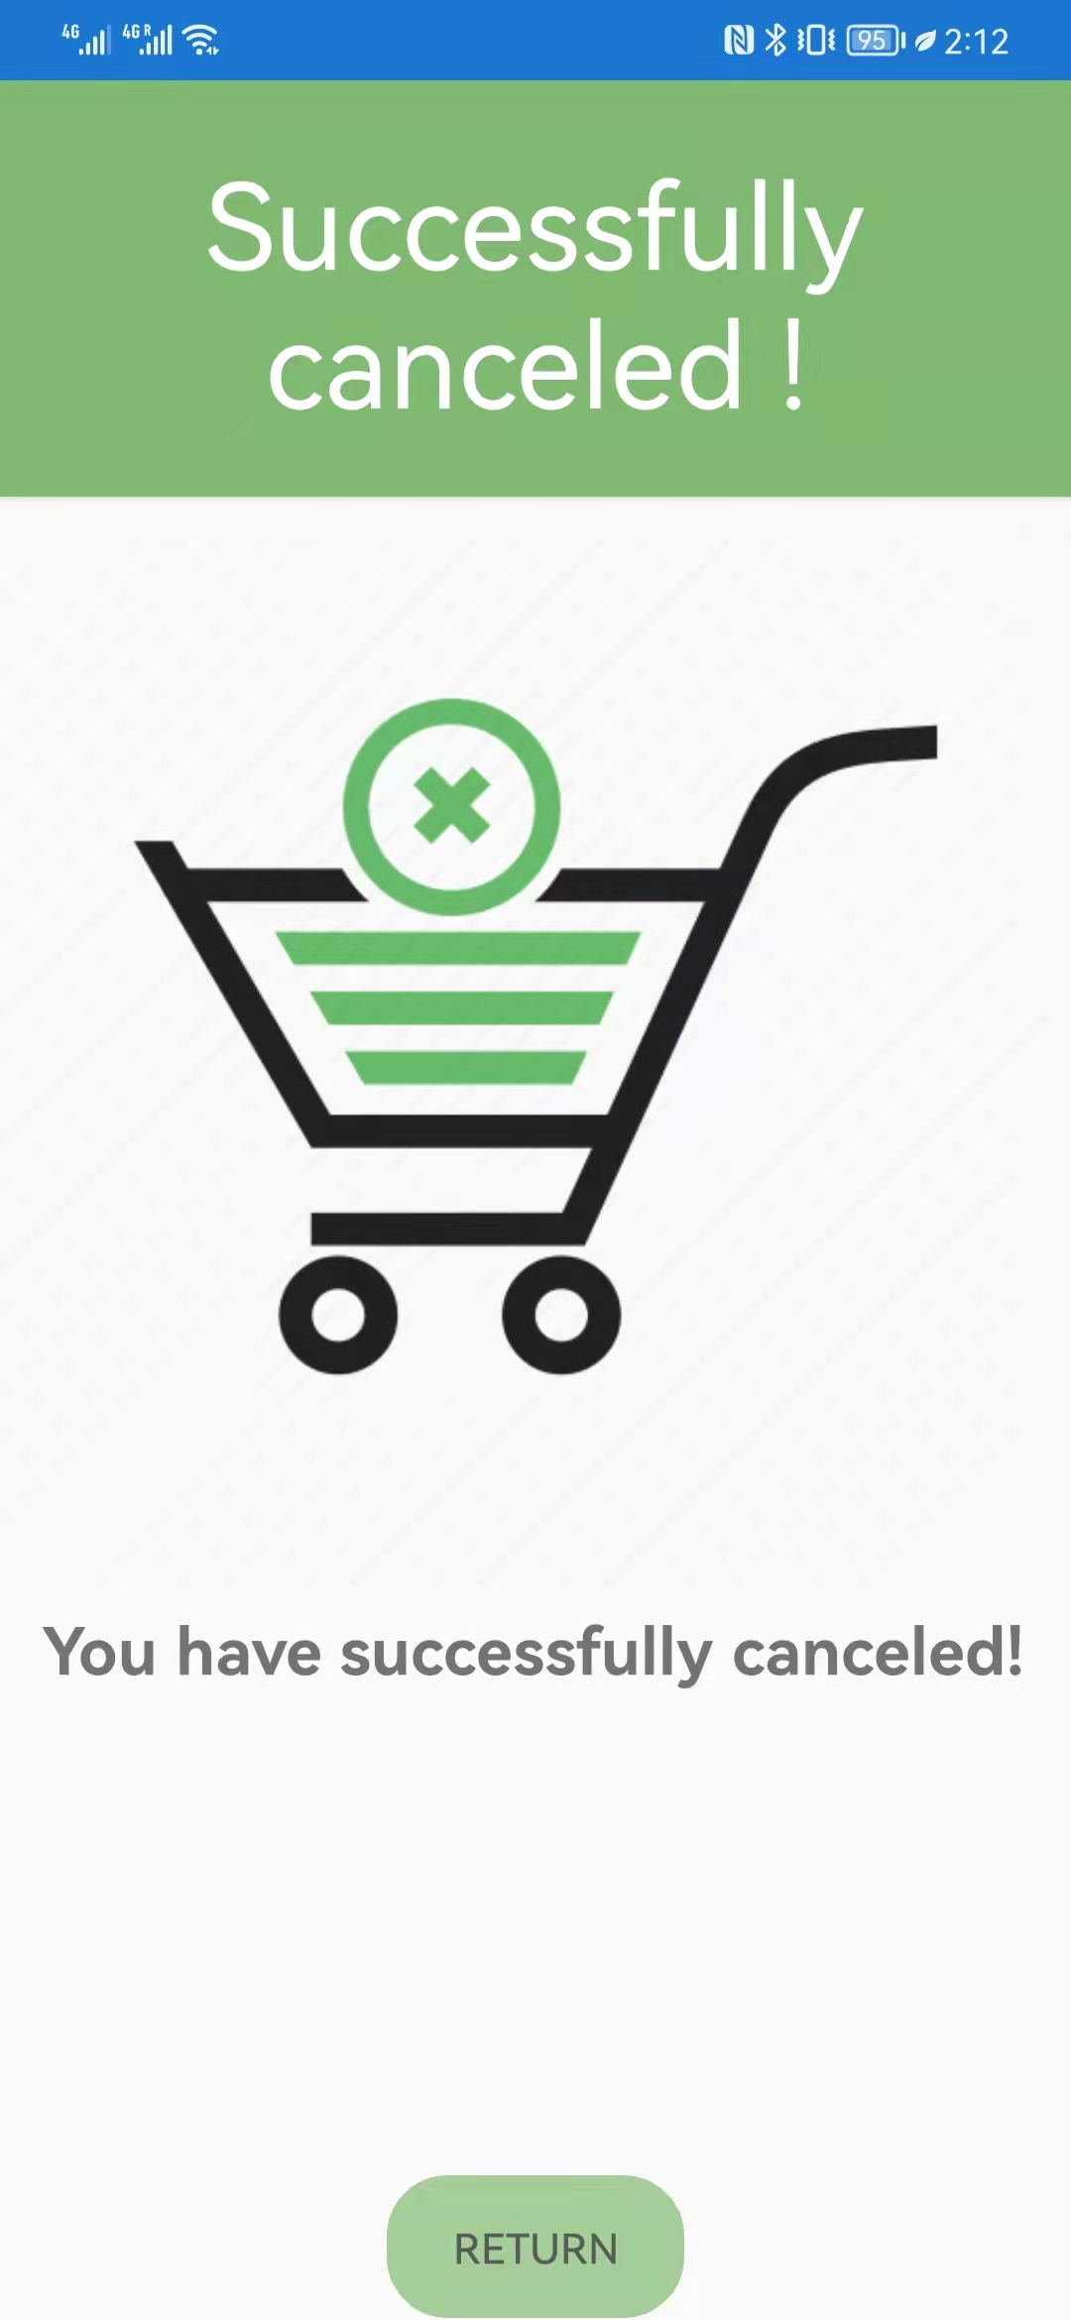
Functions – order & cancel
order
cancel
If the user want to buy the food, he can use order to take that
It a user does’t want to buy the food any more, he can cancel

Slide 15
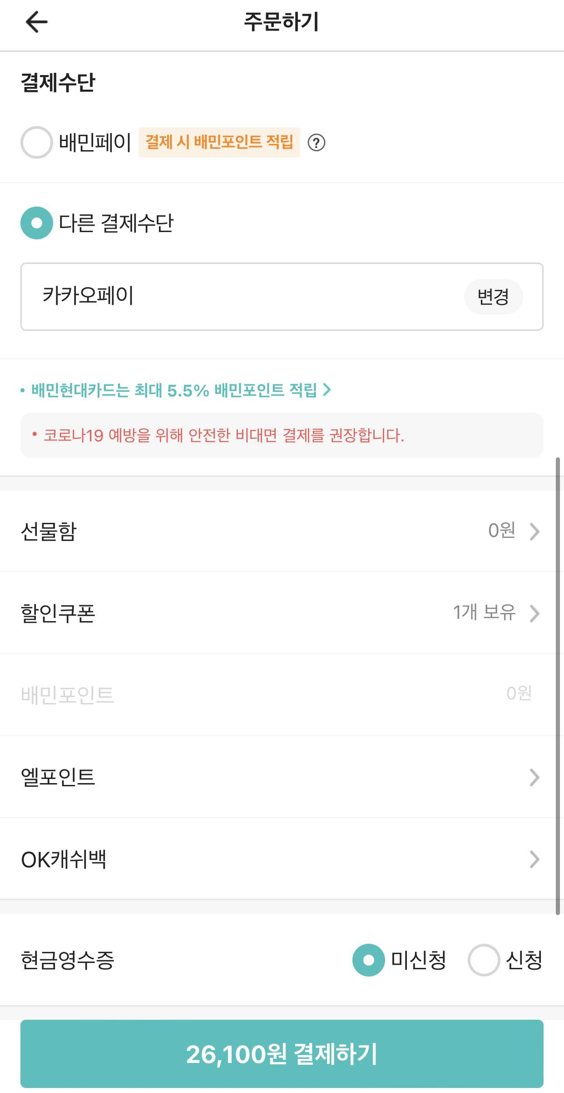
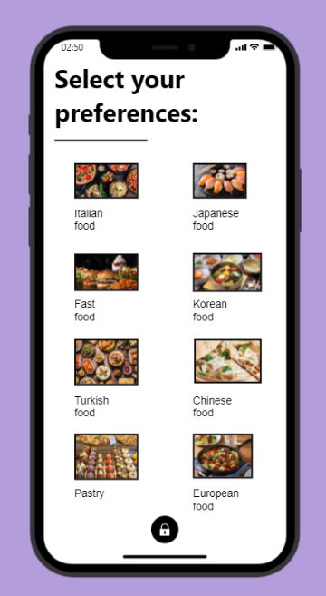
Functions – search by category & pay online
Search by category
Pay online
A user can pay online
A user can search the food by the category

Slide 16
04
Conclusion
Difficulties :
- Back-end server
- Database
Improvements :
- Fixing the Database
- Bug correction
- Adding more functionalities from the objectives

Slide 17
Thank you Q&A

